Slide 1
Ch 2 – Solving Linear Inequalities
2.1-2.3 Writing, graphing and solving inequalities

Slide 2
Inequalities
Mathematical sentences containing <, >, < or >

Slide 3
Writing Inequalities
Example 1
A number w minus 3.5 is less than or equal to -2.
3 is less than a number n plus 5.
Zero is greater than or equal to twice a number x plus one.
w – 3.5 < -2
3 < n + 5
0 > 2x + 1

Slide 4
You try!
1) A number b is fewer than 3.4.
2) -7/10 is at least twice a number k minus 4.
b < 3.4
-7/10 > 2k - 4

Slide 5
Graphing Inequalities
A graph of an inequality with one variable is on a number line.
<,> are graphed using an open point since that number is not included as a solution.
<, > are graphed using a closed point since that number is included as a solution.

Slide 6
Example 2
Graph x < 2 on a number line.
  X is less than 2
  The answer does not include 2 so use an open circle, then shade the numbers that are less

Slide 7
Example 3
Graph x > -3 on a number line.
  X is greater than or equal to -3
  The answer does include -3 so use a closed circle and shade the numbers that are greater

Slide 8
Example 4
Graph -7 > x on a number line.
  Read the inequality from the x
  X is less than or equal to -7
  The answer includes -7 so use a closed circle and shade the numbers that are less

Slide 9
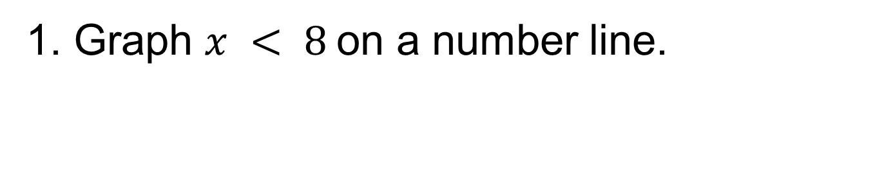
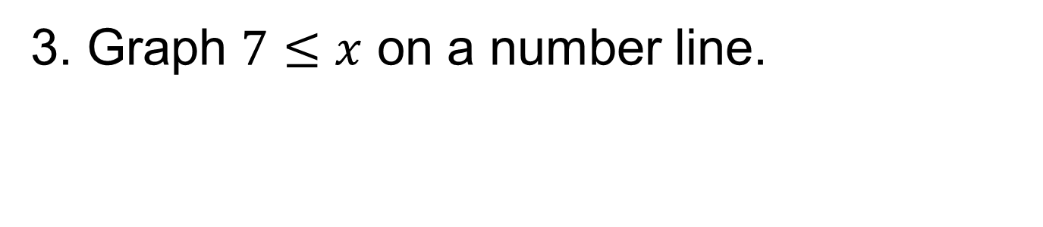
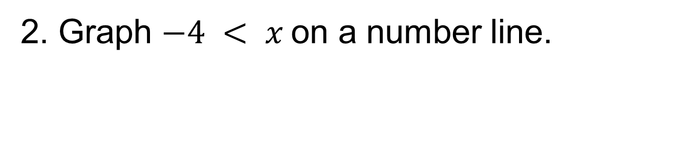
You try!
1. Graph $x < 8$on a number line.
2. Graph $−4 < x$on a number line.
3. Graph $7≤x$ on a number line.

Slide 10
Example 4
Write an inequality that represents the graph.
x > -3

Slide 11
You try!
Write an inequality that represents the graph.
x < 4

Slide 12
Solving Equations
You will solve inequalities using the same concepts that we learned in Ch 1. (distribute, combine like terms, simplify, inverse functions)
New for inequalities – flip the sign when multiplying or dividing by a negative!

Slide 13

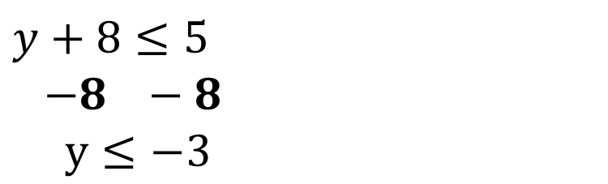
Example 1
$$x−6≥−10$$
$$+6 +6$$
$x≥−4$
Example 2
$$y+8≤5$$
$$−8 −8$$
$y≤−3$

Slide 14

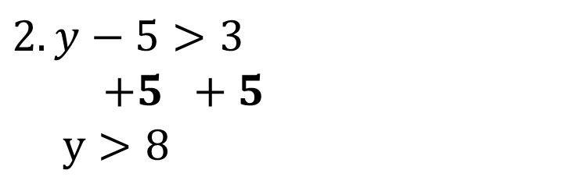
You Try!
1. $−7≤2+x$
$$−2 −2$$
$−9≤x$
$$2. y−5>3$$
$$+5 +5$$
$y>8$

Slide 15



Example 3
$$\frac{x}{8}>−5$$
$$8∗\frac{x}{8}>−5∗8$$
$$x>−40$$
Example 4
$$−24≥3x$$
$3 3$
$−8≥x$

Slide 16


Example 5
*When multiplying or dividing by a negative, you must flip the sign
$$2<\frac{y}{−3}$$
$$−3∗2<\frac{y}{−3}∗−3$$
$$−6>y$$
Example 6
$$−7y≤−35$$
$−7 −7$
$y≥5$

Slide 17



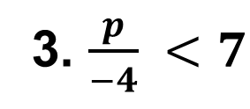
You Try!- solve and graph
$$1. \frac{n}{7}≥−1$$
2$. 4b≥36$
3. $\frac{p}{−4} <7$
$$4. −2r≤−22$$

